Slide 1
Copy Paste Content

Slide 2

A right click away

Slide 3
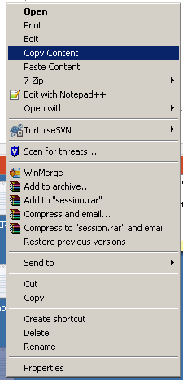
Copy the content

Slide 4
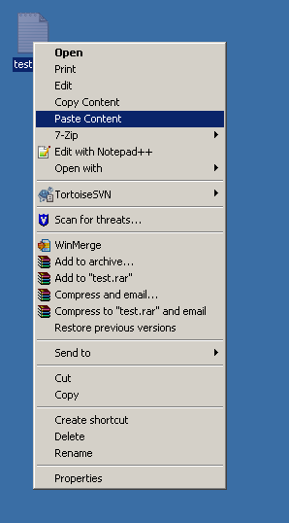
Select Destination and paste

